Slide 1
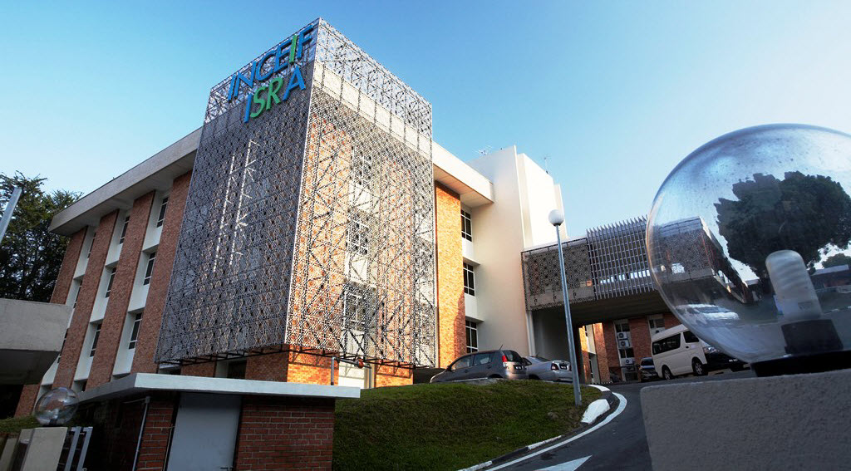
AlHuda Centre of Islamic Banking and Economics (CIBE)
7th African Islamic Finance Summit 2021
Tanzania: July 08, 2021
SHARIAH PRINCIPLES IN ISLAMIC FINANCE
Dr Fares Djafri
Researcher, ISRA

Slide 2
CONTENT
01
GLOBAL ISLAMIC FINANCE INDUSTRY LANDSCAPE
02
SHARIAH PRINCIPLES IN ISLAMIC FINANCE
03
ALIGNMENT OF MAQASID WITH SUSTAINABILITY AGENDAS
04
VALUE BASED INTERMEDIARIES (VBI) INITIATIVE
05
EXAMPLES OF VBI IMPLEMENTATION IN MALAYSIA
06
THE WAY FORWARD

Slide 3
Global Islamic Finance Industry Landscape
At the end of 2024, global size of the Islamic financial service Industry is forecasted to reach US$ 3,693 billion (ICD, 2020).

Slide 5
SHARIAH PRINCIPLES IN ISLAMIC FINANCE

Slide 6
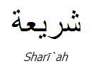
SHARI’AH AS THE FOUNDATION OF ISLAMIC FINANCE
Islam & Components of Shari’ah
Shari’ah encompasses the following meaning:
Path to tread for guidance in this world
Commands, prohibitions, values prescribed by Allah for His slaves either through Al-Quran or As-Sunnah (the teachings of the Prophet Muhammad s.a.w.)
Sharī’ah is a set of norms, values and laws that go to make up the Islamic way of life.
Shari’ah encompasses the whole dimensions of human life
I`tiqadiyah
(Belief)
`Amaliyah
(Dealings)
Akhlaqiah
(Morality)
Ibadah
(Human with Creator)
Muamalah
(Human with human)
Economics / Finance
Family Law
Criminal Law
Politics
Issues in Islamic finance

Slide 7
Shari’ah as the Basis in Islamic financial system and Islamic financial system is operating in Shariah ecosystem
ADHERING THE PRINCIPLES
The Core:
MECHANISMS
Observing the principles governing the contracts (‘aqd)
Forms/structures should be inline with the substances/goals
GOALS
Aims to realize the maqasid al-Shari’ah in the whole dimensions:
Micro goals: related to the Individuals
The Ethical Principles
The prohibition of Riba
The avoidance of Gharar
The engagement in real economic activities
Avoidance of forbidden activities
Fair & transparent financial dealings
Commitment of Islamic values
Observing the criteria of efficient, effective, fair, just and transparent
Macro goals: related to the society
System goals: related to the system itself

Slide 8
ADHERING THE PRINCIPLES OF ISLAMIC FINANCE
Islamic Finance
Gambling (Maysir)
Lawful activities
Riba Prohibition
Profit and loss sharing
Ethical and Moral values
Speculation (Qimar)

Slide 9
Ethical Principles Underlying Islamic Finance from Maqasid Perspective
Should be done in an equal rights and opportunities
Mutual consent of two parties (tarāḍi).
Avoid unfair dealings or unjustified actions such as bribery (rishwah), fraud or deception (ghish), cheating (tadlīs), etc.
Promoting Socio-Economic Justice (al-‘adālah)
Fair and Transparent Financial Practices
Benevolence (Ihsan) and making one’s work perfect
Truthfulness and Honesty (al-siqd)
It refer to avoiding hypocrisy, fulfilling promise, being punctual, and giving fair advice to the clients.
All financial transactions must be conducted in such a manner that all the parties are clear about all important facts of the transactions necessary for the avoidance of disputes, clashes or damages to any party.
Observance of Islamic values and principles such as Ihsan “excellence and perfection” and Itqan “precision of action” will lead to high level of organizational commitment and ultimately greater displays of organizational citizenship behavior at the workplace.
Notes:
5. Trust (amanah)

Slide 10
2. OPERATIONAL MECHANISM: OBSERVING THE ‘AQAD
Rukun (Pillars)
Sharat (Conditions)
TRANSACTION

Slide 11
ESSENTIALS OF VALID CONTRACT
CONTRACTUAL EXPRESSION (Sighah)
CONTRACTING
PARTIES
(Aqidan)
SUBJECT
MATTER
(Mahall al `aqd)
Offer
Acceptance
Offeror
Offeree
Goods/
asset
Price/
consideration
Clear
Consensus ad idem
Corresponding offer & acceptance
Of full contractual capacity (ahliyyah al-ada’ al-kamilah)
Legal authority to contract
As owner & in possession of asset
legal representative (agent, guardian etc.)
Something of value
Ascertainable
Legal

Slide 12
Other Shari’ah Mechanisms for Effective Implementation of its Objective in Business and Finance
Prohibition and Prevention of Unethical Behaviours in Business and Finance
Preservation of Wealth
This is an essential elements in maqasid al-Shari’ah. It includes acquiring it in a legitimate way and avoiding engaging in Shari’ah non-compliant activities.
All forms of harmful monopoly are forbidden whether in goods, money or any other form.
Wealth Circulation in Society
It includes all the processes related to wealth creation, consumption and distribution.
Circulation of the wealth among the largest number of people would definitely bring prosperity and happiness to the whole society.
This objective has been strengthened by several rulings and other financial transactions such as Mudarabah, Musharakah, Muzara’ah, Mugharasah, and Musaqah etc
Safeguard of Public Interest in Business and Finance
It refers to the consideration of people’s well-being in every aspect of life including commercial transactions
In the modern context, licensing and supervisory authorities today plays to a certain degree the role of hisbah along the institution of ombudsman. With that, market behaviour embraces Islamic ethical values and strictly adheres to them in daily transactions.
Adherence to justice and promotion of ethical values in business
Adherence to Islamic ethical conduct is an integral part of compliance with Shari’ah requirements.
Shari’ah enjoins certain values including among others trust, honesty, integrity, responsibility and openness.
THIS SHARI’AH MECHANISM AIMS TO REALIZE THE MAQASID SHARI’AH IN ISLAMIC FINANCE
Notes:
5. Prohibition and Prevention of Unethical Behaviours in Business and Finance which include the prohibition of Riba, gharar, hoarding and monopoly
This Shari’ah mechanism aims to realize the Maqasid Shari’ah in Islamic Finance.
Apart from the ethical principles which guide inner conducts, Shari’ah puts in place fundamental Shari’ah principles and mechanisms to effectively accomplish objectives of Shari’ah (maqasid al-Shari’ah). These involve firstly adherence to justice and promotion of ethical values in business and finance; secondly, safeguard of public interest in business and finance; thirdly, removal of hardship and prevention of unethical behaviours in business and finance.

Slide 13
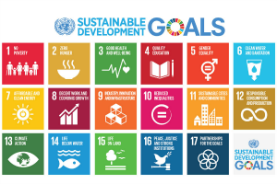
Alignment of Maqasid with Sustainability Agendas
PROMOTING WELL-BEING OF MANKIND:
1. Facilitation of ease/promotion of good
2. Removal of hardship/harm for human being
Maqasid
Preservation of Religion
Preservation of Life
Preservation of Intellect
Preservation of Lineage
Preservation of Wealth
ESG
Environment | Social | Governance
SDG
Goal 6: Clean Water and Sanitation Goal 7: Affordable and Clean Energy Goal 11: Sustainable Cities and Communities Goal 12: Responsible Consumption and Production Goal 13: Climate Action Goal 14: Life Below Water Goal 15: Life on Land | Goal 1: No Poverty Goal 2: Zero Hunger Goal 3: Good Health and Well-being Goal 4: Quality Education Goal 5: Gender Equality Goal 8: Decent Work and Economic Growth Goal 9: Industry, Innovation and Infrastructure Goal 10: Reduced Inequality Goal 11: Sustainable Cities and Communities | Goal 16: Peace and Justice Strong Institutions Goal 17: Partnerships to Achieve the Goal
2

Slide 14
The SDGs’ agenda is an opportunity to present the value proposition of Islamic finance to the world economy in a language understood by all.
The SDGs can play a role in enlightening the world about maqasid al-Shariah and the position they occupy in Islamic finance.
Islamic finance can leverage on the infrastructure provided for SDGs to develop new sustainable products.
In pursuing SDGs in socio-economic activities, Islamic Social finance instruments such as waqf, zakat and sadaqah will rank supreme due to their potential in instilling cooperation, solidarity and alternative finance.
Alignment of Maqasid with Sustainability Agendas

Slide 15
BNM and Value Based Intermediaries (VBI) Initiatives
In line with the international trend of incorporating other values other than just profit, the Central Bank of Malaysia developed a strategy paper on Value Based Intermediation (VBI) in 2018.
The VBI initiatives by Bank Negara Malaysia (BNM) aims to deliver the intended outcomes of Shari’ah through practices, conducts and offerings that generate positive and sustainable impacts to the economy, community and environment, consistent with stakeholders’ sustainable returns and long-term interests.
It advances a rational of “not just Shari’ah compliance” to establish a culture that establishes the intended outcomes of Shari’ah (BNM, 2018). VBI aims to achieve the goals of the economy, society, and the environment, all within the Maqasid al-Shariah. With these outcomes of Shariah being justice, wealth protection, and wealth circulation, amongst several others.
The underpinning Thrusts of VBI
Notes:
The aim of VBI is to provide finance that has a social economic impact meaning to say VBI aims to achieve the goals of the economy, society, and the environment, environment should not be harmed
The VBI initiatives by Bank Negara Malaysia (BNM) aims in creating an enabling environment for IBIs in Malaysia to adopt relevant practices, offerings and conduct that generate positive and sustainable impact to the economy, community and environment, without compromising the financial returns to shareholders.
BNM requires IBIs to ensure that the intent, strategy and performance of their Islamic financial businesses are premised on the underpinning areas of VBI that will eventually create values to the stakeholders.
VBI aims to achieve the goals of the economy, society, and the environment, all within the Maqasid al-Shariah, with these outcomes of Shariah being justice, wealth protection, and wealth circulation, amongst several others.

Slide 16
Transforming the Practices of Malaysian Islamic Finance Industry
Some Expectations on the Value-based banking practices:

Slide 17
Overall Framework of Value-based Intermediation (VBI)
Notes:
In line with the international trend of incorporating other values other than just profit, the Central Bank of Malaysia developed a strategy paper on Value Based Intermediation (VBI) in 2018. It is an intermediation function that aims to deliver the intended outcomes of Shari’ah through practices, conducts and offerings that generate positive and sustainable impacts to the economy, community and environment, consistent with stakeholders’ sustainable returns and long-term interests. It advances a rational of “not just Shari’ah compliance” to establish a culture that establishes the intended outcomes of Shari’ah (BNM, 2018).
This definition signifies that The VBI initiative aims in creating an enabling environment for Islamic banking institutions (IBIs) in Malaysia by focusing on sustainable impact to the economy, community and environment without compromising the financial returns to shareholders.
VBI is another attempt to integrate Islamic finance with maqasid al-Shari’ah and the values propagated are also in line with ethical considerations in Shari’ah.

Slide 18
Key Differences between VBI and SRI
Value-based Intermediation (VBI)
Sustainable Responsible Investment (SRI)
Intermediation that considers economics, social and environment in Islamic banking
Values derived from Maqasid al-Shariah
Retail, Corporate
Re-aligning Islamic banking towards “substance over form” based on Maqasid al-Shariah
Values fixed and permanent
Intermediation that considers economics, social, environment and governance in capital markets
Values derived from pure economic, social and environmental frameworks, but may be Shariah-compliant
Corporate, Government
Re-aligning capital market activities towards “substance over form” based on local and global sustainable strategic initiatives (SDGs, ESG, etc.)
Values changeable and may affect SRI outputs

Slide 19
Examples of VBI Implementation in Malaysia
Rent-To-Own solution (RTO) Houzkey (Maybank)
This is an alternative method of home financing by way of a lease agreement (“Lease Agreement”) based on the Islamic concept of Ijarah (lease) that includes an option to purchase (via cash or mortgage) after servicing 12 months rental.
It will be able to assist customers who have difficulties in securing homeownership due to the high initial costs.
HouzKEY is a new way to own your home. It provides greater flexibility and cash flow efficiency, specially designed to assist those who intend to be homeowners but are unable due to the high initial cost.
Instead of forking out a 10% down payment and additional transactional fees upfront like you would with a traditional mortgage, you only pay a three-month security deposit to secure a property with HouzKEY.

Slide 20
Sadaqa House (Bank Islam)
Sadaqa House is a donation platform operated by Bank Islam which enables funds to be channelled to the needy communities through Bank Islam partners. This is one of the efforts to create more sustainable economic development, community and environment.

Slide 21
MOVING FORWARD
Shariah compliance is the backbone of the operation of Islamic financial institutions (IFIs) as it gives legitimacy to their products and practices.
IFIs should be developed with broader understanding of Shari’ah and pursuing the higher objectives of Shari’ah.
Maqasid al-Shari’ah would act as the framework and guideline as well basis and foundations in developing an Islamic financial system.
The SDGs’ agenda is an opportunity to present the value proposition of Islamic finance to the world economy in a language understood by all.
Adherence to Shariah principles and maqasid al-Shari’ah as the grand objective of Islam is necessary for developing genuine and indisputable Islamic finance.
Broadening the Meaning of Shari’ah Compliance through expanding the emphasis into the meaning and substance of Shariah rather than technical and operational sense in developing products.

Slide 22
THANK YOU!
DR Fares Djafri
fares@isra.my

